Slide 1
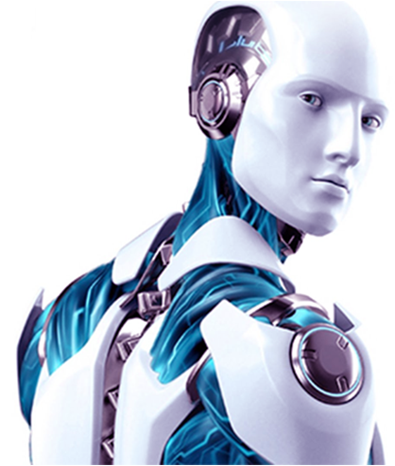
What is Artificial Intelligence?
Chris Hamling
AI Software Engineer – ATC AI/ML
October 31, 2018

Slide 2
My Gift to You
Artificial Intelligence Repository
matt-versaggi.com/mit_open_courseware
This is the AI Repository compiling years of biz / tech AI materials in this one space.
Secure Group: “WebAuthOnlineStorage_Box”
Actively Maintained

Slide 3
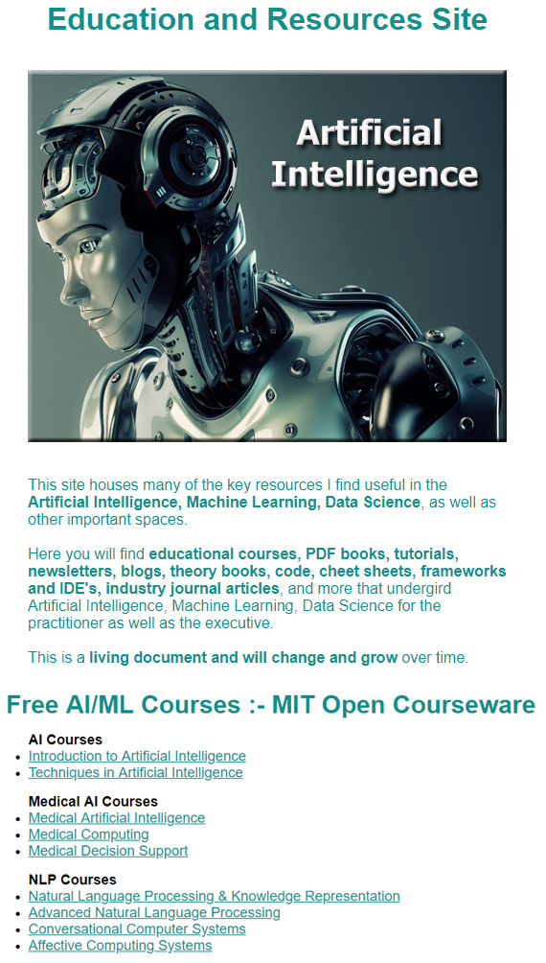
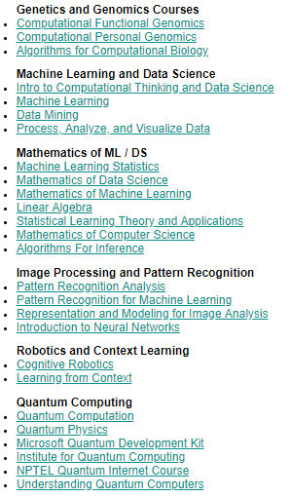
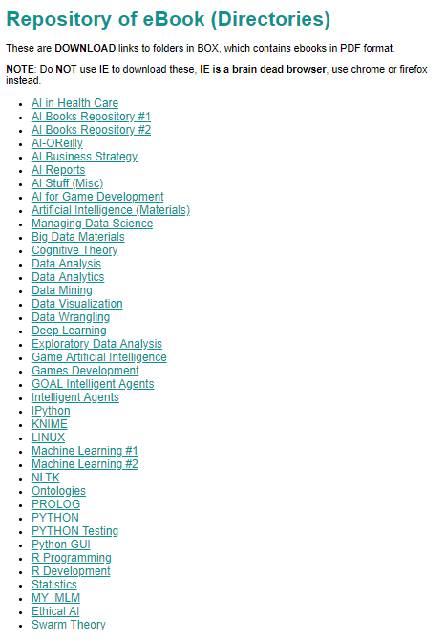
Education and Resources Site

Slide 4
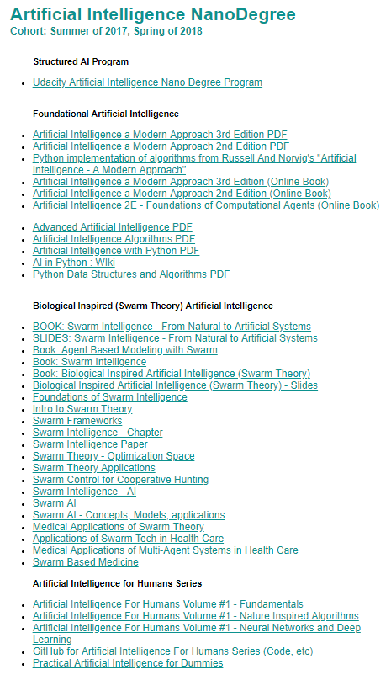
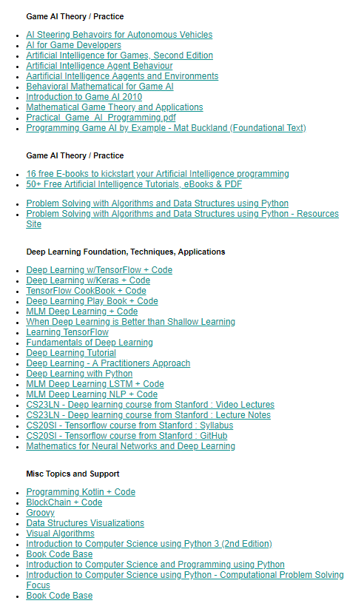
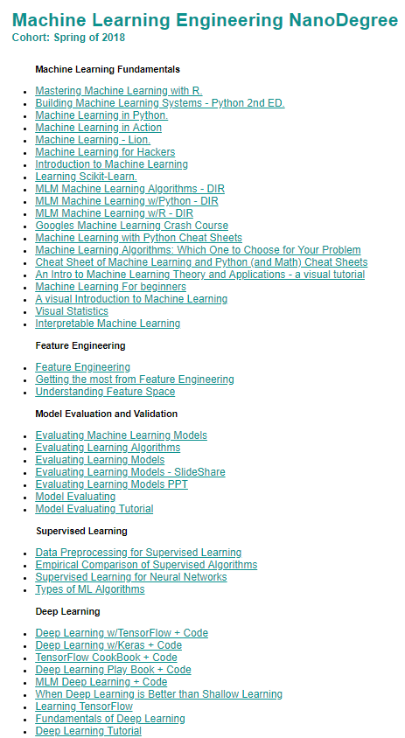
Education and Resources Site Continued

Slide 5

About: Matthew R. Versaggi
Sr. Dir of AI / ML
Optum Technology
Artificial Intelligence
Engineer
Military Contractor
Philosopher
Education
Entrepreneur
CEO IT company
Nearly 20 years
Passion decades long
Dozen+ formal courses
AI Developer
4 University Degrees
BA - Comp Science
BS - Fin / MIS
MS - CS (AI)
MBA – (Int Biz/Econ)
5 Professional Certificates
2 in Security (Server/Network)
1 Data Science / Machine Learning
1 Artificial Intelligence
1 Quantum Computing
Adj unct
Professor
DePaul University
Graduate School of Business
8 years
Teaching Award
CNA Insurance
CIO
Dental Insurance Co.

Slide 6
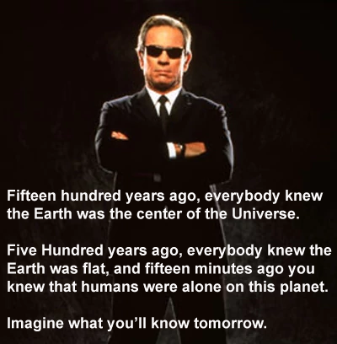
Goal: To Educate and Inspire
Vehicles of choice:
Definitions (essence statement)
Explanations
Infographics
Live Demos
Retrospectives
Method:
Heavy on the demo’s, light on PPT
Talk to the “top” of the room.
Retrospectives: “Show of Hands”
Other Goals:
Prompt Adoption
Practitioner(s), Domain(s), & Department(s)
OTU => College of AI

Slide 7
Artificial Intelligence Overview
Agenda
Terms & Definitions
Data Science & Machine Learning
Deep Learning
Intelligent Agents
Graph DB's & Knowledge Representation
If Time Permits: Quantum Computing
Optum Tech University –> College of Artificial Intelligence
Questions
* Live Demo’s for each segment

Slide 8
Terms and Definitions
What is Artificial Intelligence?
The essence of Artificial Intelligence is about emulating the following human characteristics with the hope of actually creating them someday:
Learning
Reasoning
Problem Solving
Perception
Planning
Language
Actuation (movement)
*Evolutionary*

Slide 9
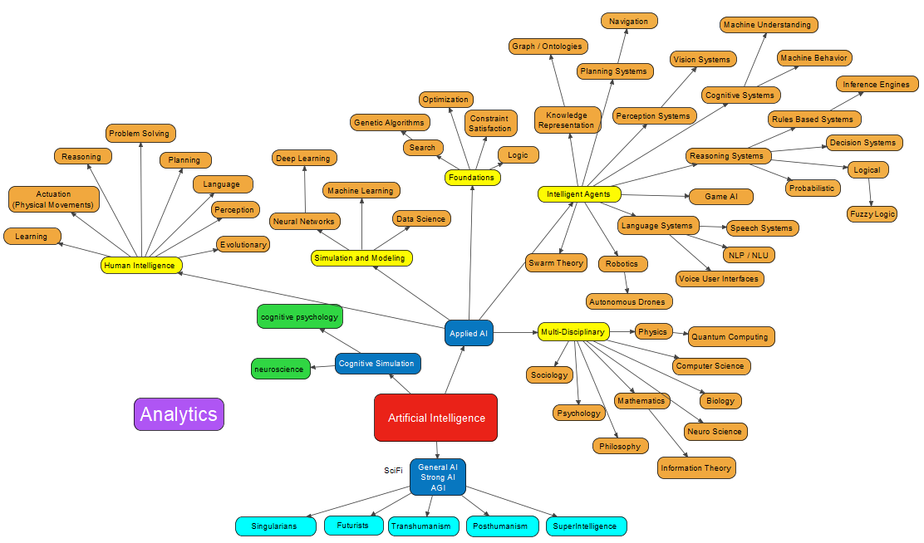
Terms and Definitions - What is Artificial Intelligence
Big Picture View

Slide 10
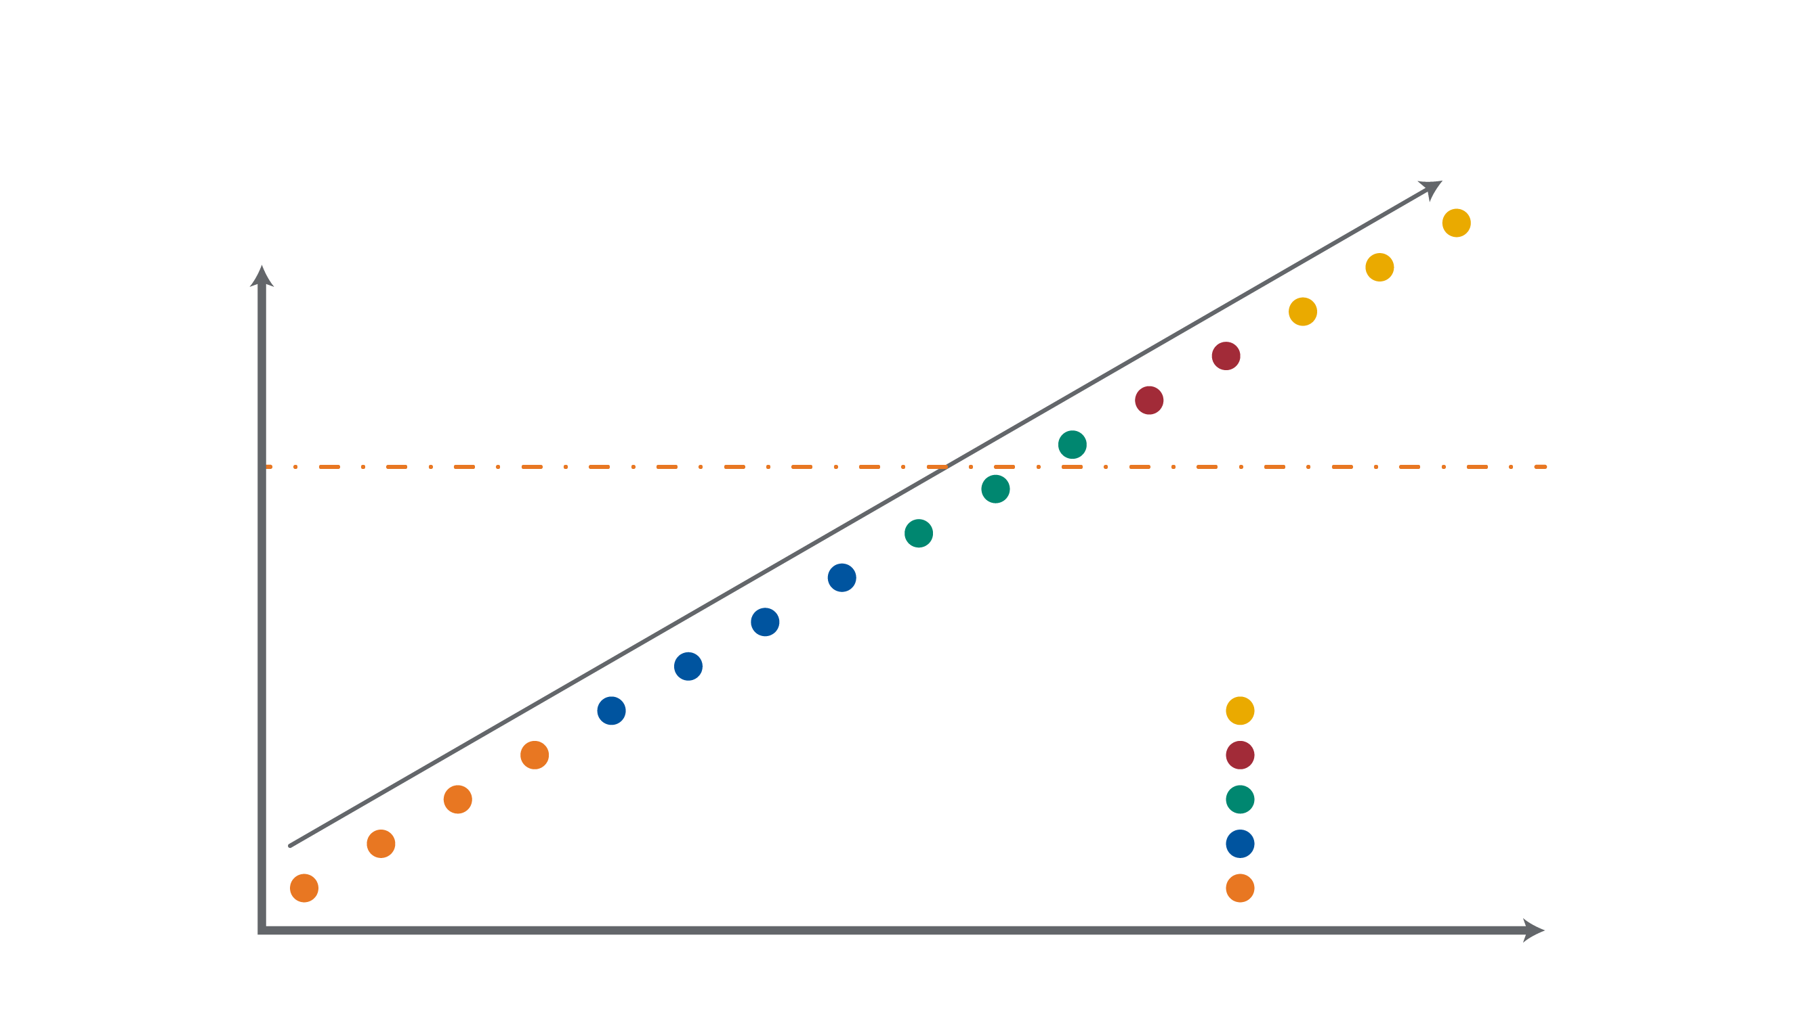
Terms and Definitions - What is Artificial Intelligence
Data Centric View
Reasoning
Learning
ML/AI
Natural Language
Optimization
Rules
Demarcation Line
Predictive Modeling
Forecasting
Statistical Analysis
Context Specific Usage
Alerts
Drilldown Query
Ad Hoc Reports
Standard Reports
Cognitive
Big Data Platforms
Analytics
Prescriptive
ECM
Predictive
Information Integration
Descriptive
RDBMs
Information Foundation
Natural, Intuitive or Automated Interaction

Slide 11
Recap: Terms and Definitions - What is Artificial Intelligence
Activities View
Definition(s):
Artificial intelligence (AI), the ability of a digital computer or computer-controlled robot to perform tasks commonly associated with intelligent beings.
The modern definition of artificial intelligence (or AI) is "the study and design of intelligent agents" where an intelligent agent is a system that perceives its environment and takes actions which maximizes its chances of success.
In general terms, AI refers to a broad field of science encompassing not only computer science but also psychology, philosophy, linguistics and other areas.
AI is concerned with getting computers to do tasks that would normally require human intelligence, defined below.
Learning
Reasoning
Problem Solving
Perception
Language
Actuation (Movement)
Evolutionary
Artificial intelligence is generally classified into three parts:
General AI
Applied AI
Cognitive Simulation

Slide 12
Retrospective (AI) :- Show of Hands
Questions:
How many now have a better conceptualization of what AI actually is, and conversely, what it is not?
How many wrote down the AI Repository link?
( matt-versaggi.com/mit_open_courseware )
Secure Group: “WebAuthOnlineStorage_Box”

Slide 13
Data Science
What is Data Science?
The essence of Data Science is the extraction of knowledge and insights from data (aka Data Mining).

Slide 14
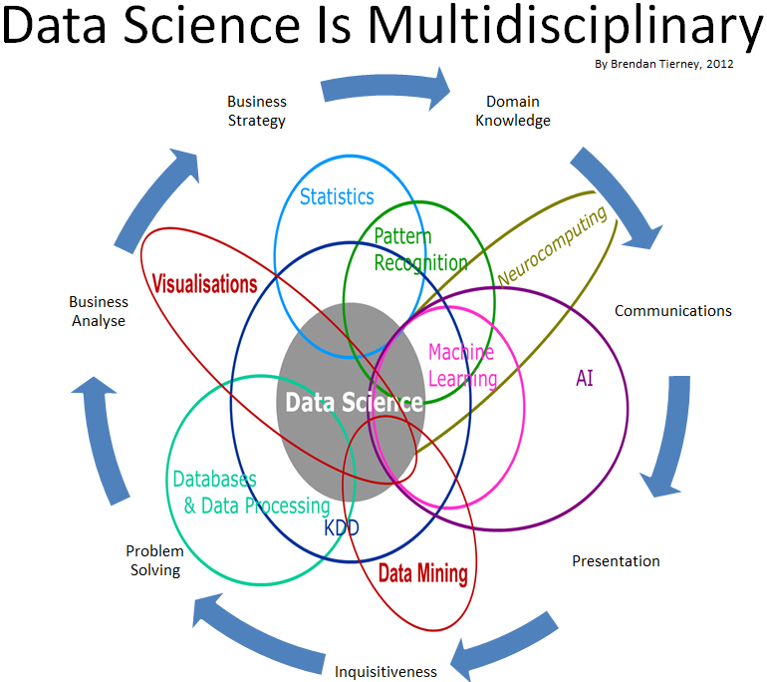
Data Science

Slide 15
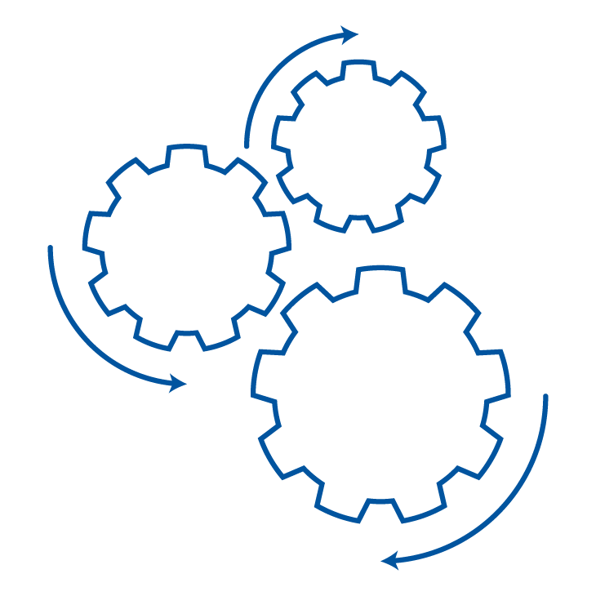
Data Science
Data Science Lifecycle
Business Understanding
Start
Data Source
On-premises vs Cloud Database vs Files
Transform, Binning, Temporal, Text, Image, Feature Selection
Feature Engineering
Modeling
Data Acquisition & Understanding
Pipeline
Streaming vs Batch Low vs High Frequency
Algorithms, Ensemble Parameter Tuning, Retraining Model Management
Model Training
Environment
On-premises vs Cloud Database vs Data Lake vs Small vs Medium vs Bid Data
Cross Validation, Model Reporting, A/B Testing
Model Evaluation
Deployment
Wrangling, Exploring & Cleaning
Structured vs Unstructured Data Validation and Cleanup Visualization
Model Store
Customer Acceptance
End
Web Services
Intelligent Applications
Scoring, Performance Monitoring, etc.

Slide 16
Recap: - Data Science
What is Data Science?
Data Science is the extraction of relevant insights from data. It uses various techniques from many fields like mathematics, machine learning, computer programming, statistical modeling, data engineering and visualization, pattern recognition and learning, uncertainty modeling, data warehousing, and cloud computing.
Data Science does not necessarily involve big data, but the fact that data is scaling up makes big data an important aspect of data science.

Slide 17

Data Science
DEMO: Titanic Case Study

Slide 18
Retrospective (Data Science) :- Show of Hands
Questions:
How many see how the techniques and algorithms used can actually add insights, which might otherwise be hidden?
How many of you would buy a first class ticket if you were a passenger on the Titanic?

Slide 19
Machine Learning
What is Machine Learning?
The essence of Machine Learning is learning from data with little (or no) human intervention.

Slide 20
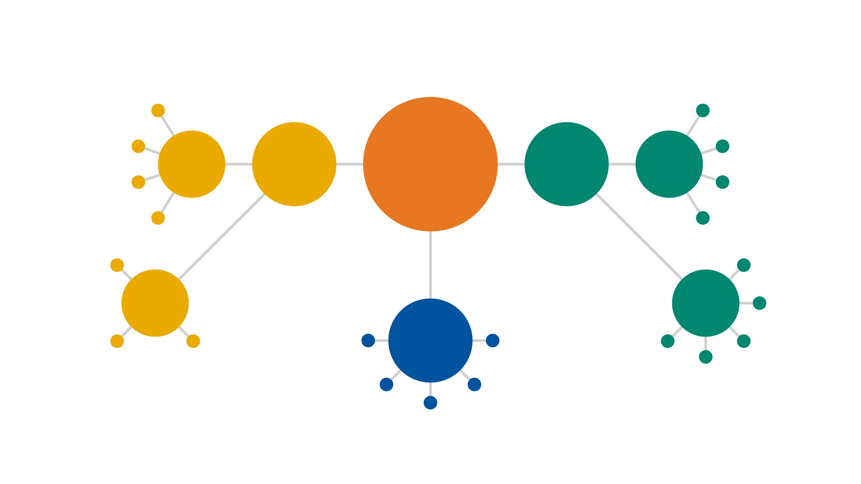
Machine Learning
Feature Elicitation
Identity Fraud Detection
Structure Discovery
Image Classification
Dimensionality Reduction
Unsupervised Learning
Machine Learning
Supervised Learning
Classification
Meaningful Compression
Customer Retention
Big Data Visualization
Diagnostics
Recommender Systems
Clustering
Regression
Weather Forecasting
Market Forecasting
Targeted Marketing
Customer Segmentation
Real-time Decisions
Game AI
Reinforcement Learning
Popular Growth Prediction
Estimating Life Expectancy
Robot Navigation
Skill Acquisition
Advertising Popularity Prediction
Learning Tasks

Slide 21
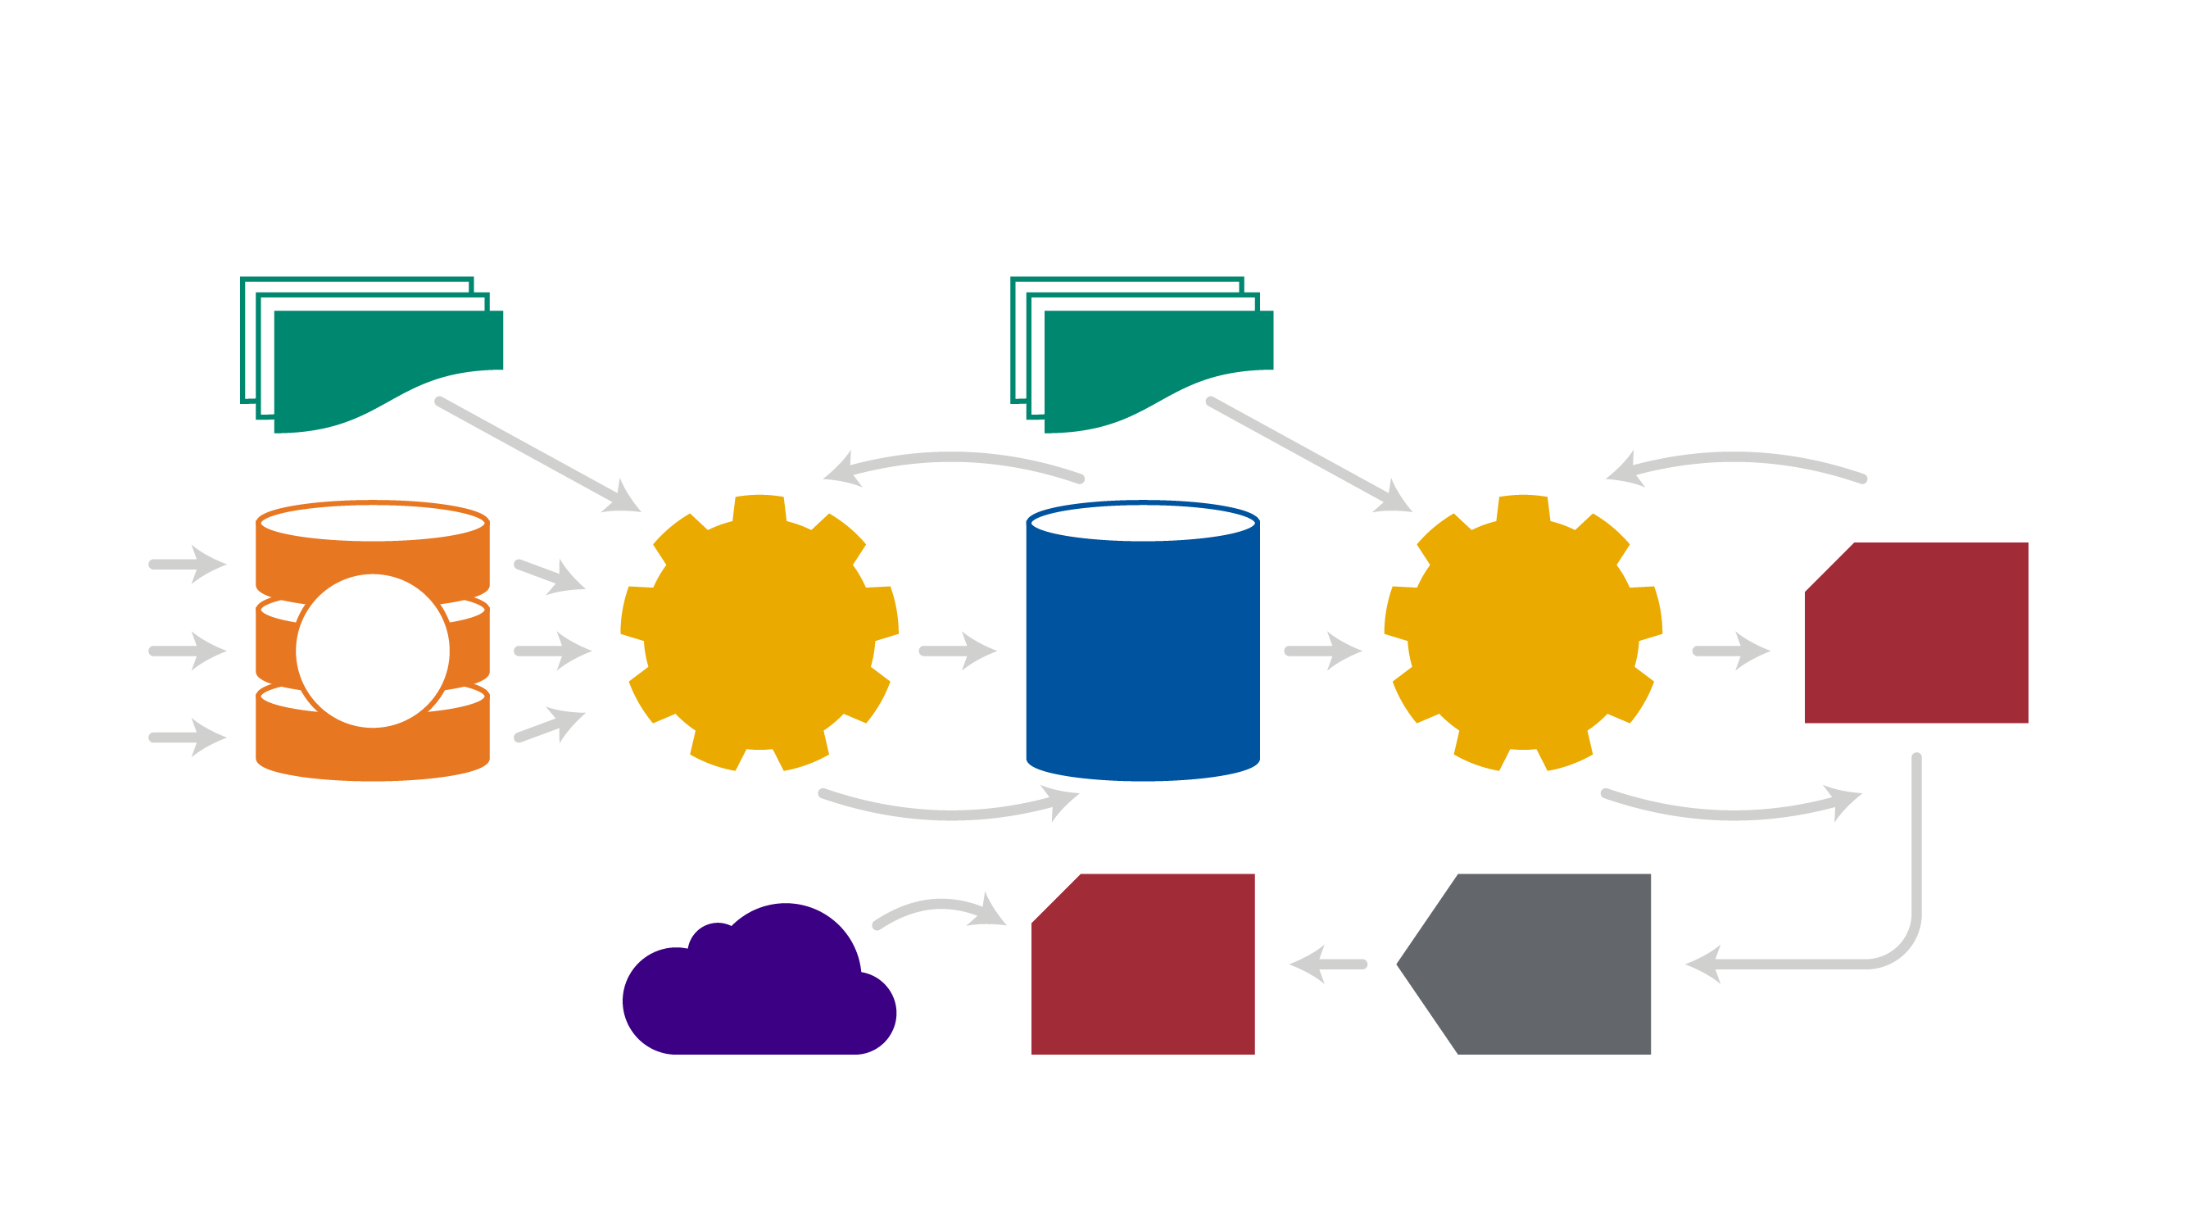
Machine Learning
Data Processing Tools
Machine Learning Algorithms
Iterate Until Data is Processed
Iterate to Get the Best Model
Data Providers
Raw Data
Pre- Processing
Structured Data
Learning Algorithms
Candidate Model
Select Data
Golden Model
Deploy Selected Model
Applications

Slide 22
Recap: - Machine Learning
What is Machine Learning?
Machine learning is the ability of a computer system to learn from the environment and improve itself from experience without the need for any explicit programming.
The classic machine learning procedure follows the scientific paradigm of induction and deduction. In the inductive step we learn the model from raw data (the training set), and in the deductive step the model is applied to predict the behavior of new data.
The three basic models of machine learning are supervised, unsupervised and reinforcement learning.
Machine Learning has 2 modalities – shallow and deep (abductive reasoning).

Slide 23
Machine Learning
DEMO: Sonar Case Study

Slide 24
Retrospective (Machine Learning) :- Show of Hands
Questions:
How many now feel they better understand how machine learning differs from data science?
How many now understand the need for algorithm competitions, and how the characteristics of the data influence the effectiveness of the algorithm choice(s)?

Slide 25
Deep Learning
What is Deep Learning?
The essence of Deep Learning is automatic feature engineering to facilitate learning in Neural Networks with many layers.

Slide 26
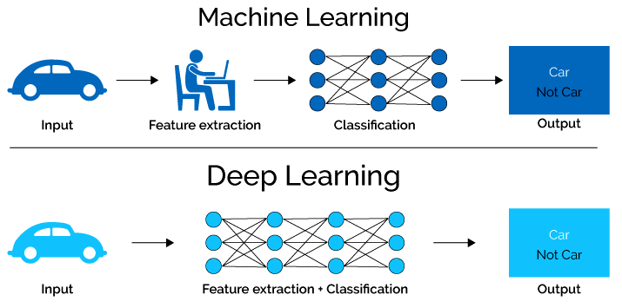
Deep Learning

Slide 27
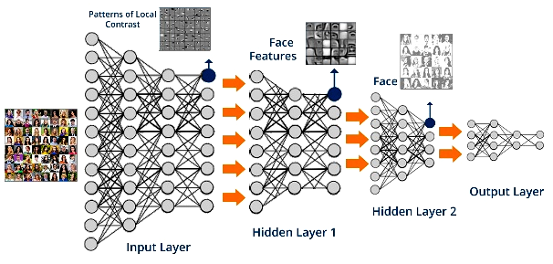
Deep Learning - Architecture

Slide 28
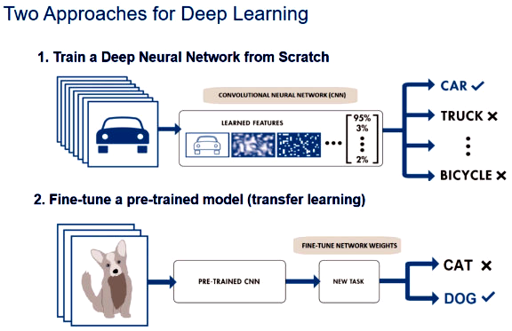
Deep Learning – Two Modalities

Slide 29
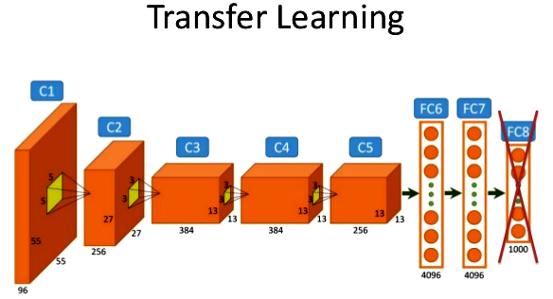
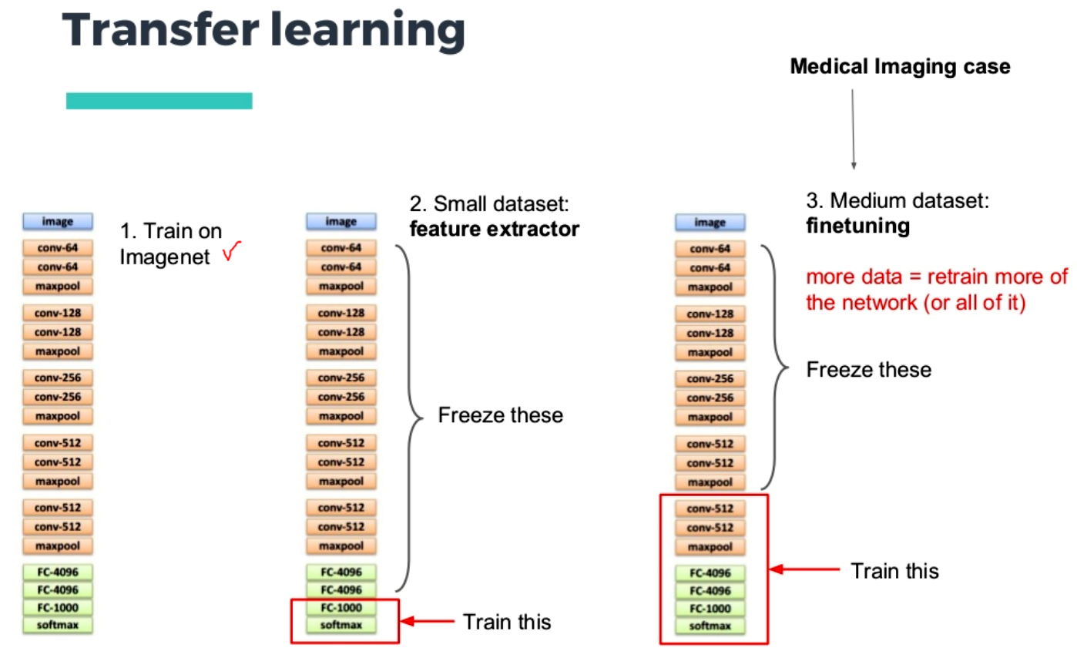
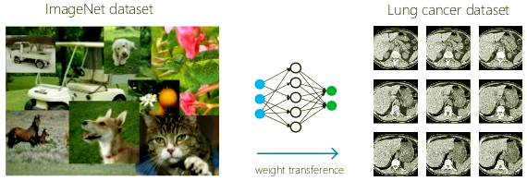
Deep Learning – Transfer Learning

Slide 30
Recap:- Deep Learning
What is Deep Learning?
Deep Learning is an aspect of artificial intelligence (AI) that is concerned with emulating the learning approach that human beings use to gain certain types of knowledge. At it's simplest, deep learning can be thought of as a way to automate predictive analytics.
Deep learning is a class of methods and techniques that employ artificial neural networks with multiple layers of increasingly richer functionality. While traditional machine learning algorithms are linear, deep learning algorithms are stacked in a hierarchy of increasing complexity and abstraction. It is Abductive Reasoning – “give it your best shot given what you know”.
In traditional machine learning, the programmer has to be very, very specific when telling the computer what types of things it should be looking for when deciding if an image contains a dog or does not contain a dog. This is a laborious process called feature extraction and the computer's success rate depends entirely upon the programmer's ability to accurately define a feature set for dog. The advantage of deep learning is that the program builds the feature set by itself. This is not only faster, it is usually more accurate.
Because deep learning programming is able to create complex statistical models directly from its own iterative output, it is able to create accurate predictive models from large quantities of un-labelled, unstructured data.

Slide 31
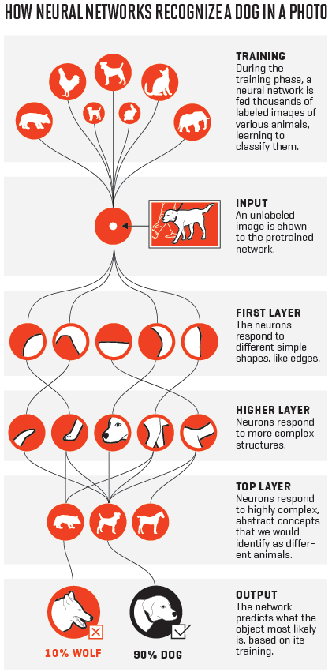
Deep Learning
DEMO: DL Dog Breed App: How Neutral Networks Recognize a Dog in a Photo
1
4
5
2
6
3

Slide 32
Retrospective (Deep Learning) :- Show of Hands
Questions:
How many now feel they better understand how deep learning differs from shallow learning?
How many now understand the value of transfer learning in deep neural networks?
How many now understand the value that the auto feature extraction capabilities provides?

Slide 33
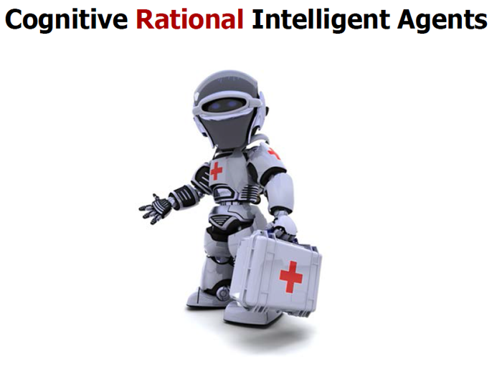
Intelligent Agents

Slide 34
Intelligent Agents
What are Intelligent Agents?
The essence of Intelligent Agents is the creation of an entity(s) that embodies intelligent characteristics, perceives it's environment, and autonomously takes action(s) to achieve a particular goal - either as a singleton or self organizing as a collective (swarm).

Slide 35
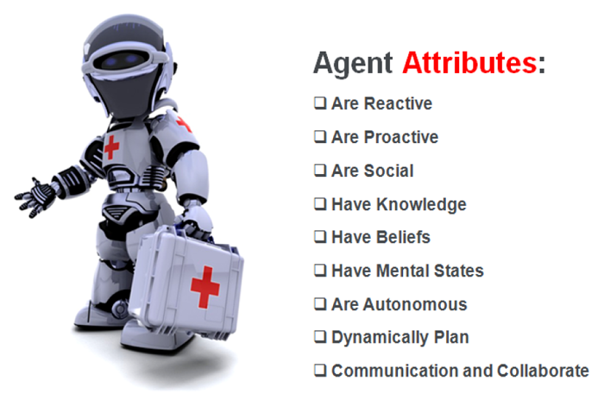
Intelligent Agents Characteristics

Slide 36
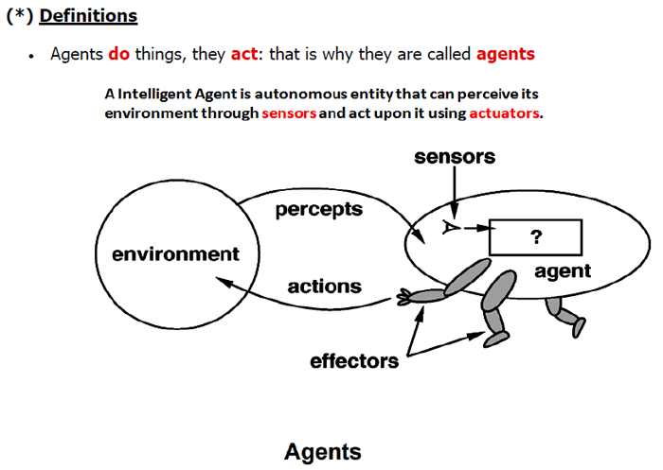
Intelligent Agents

Slide 37
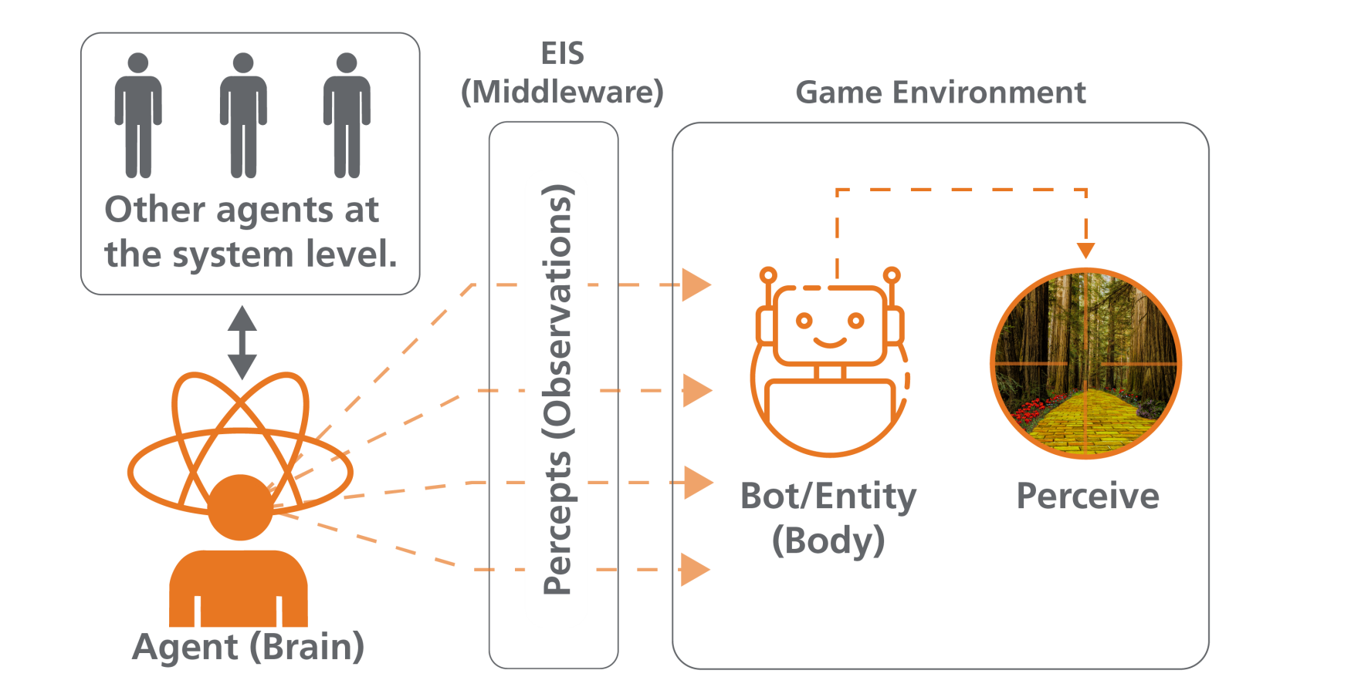
Intelligent Agents
(1) Metaphor (Easiest way to Understand Agents)
Metaphor: Gaming
NOTE: Agents can exist (both) at a System Level and as a Control Mechanism for Entities in an environment.
EIS – Environmental Interface Standard (middleware)

Slide 38
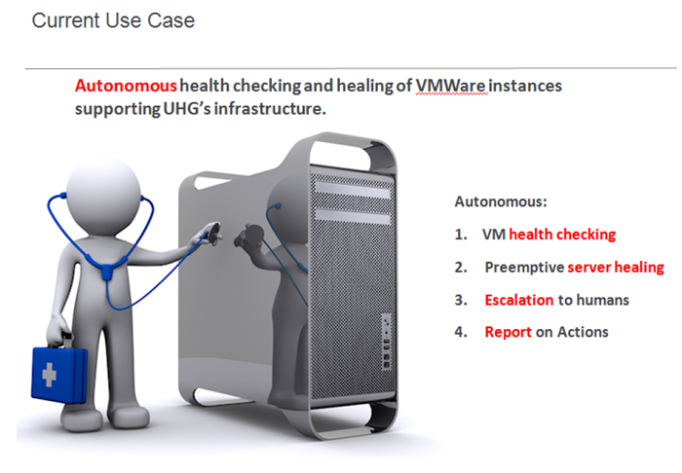
Intelligent Agents

Slide 39
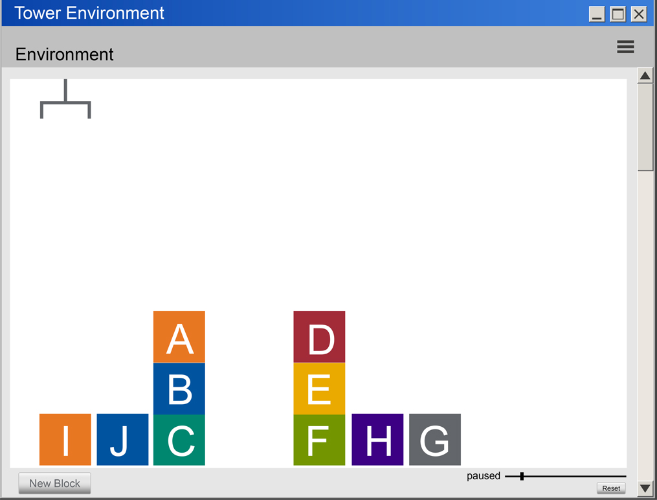
Intelligent Agents
DEMO: Very Simple Example – “Blocks Tower World”
Agents
BOT/Entity Actions
Percepts
Entities
E.I.S.

Slide 40
Retrospective (Intelligent Agents) :- Show of Hands
Questions:
How many now feel they understand the useful capabilities intelligent agents bring as singletons, and can now imagine how that changes as they begin to self organize (swarm)?
How many can conceptualize the kinds of problems that might be addressed by swarming intelligent agent technology?
How many now are thinking of intelligent agent(s) use cases in your own domain?

Slide 41
Graph Databases
What are Graph Databases?
The essence of Graph Databases is the capture and treatment of relationships between the data as vital information. Graph Databases are excellent for use cases which leverage many-to-many relationships and/or place a premium on the relationships between data elements.

Slide 42
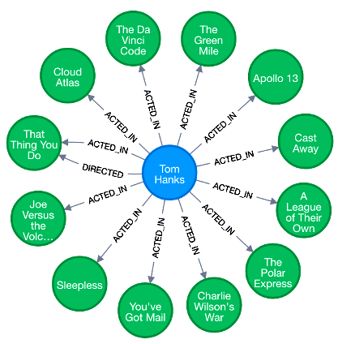
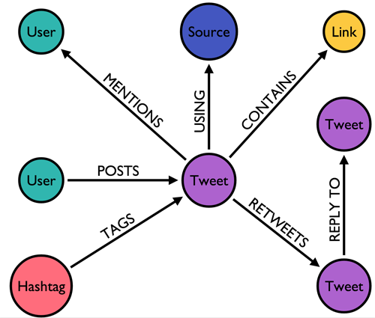
Graph Databases : Examples

Slide 43
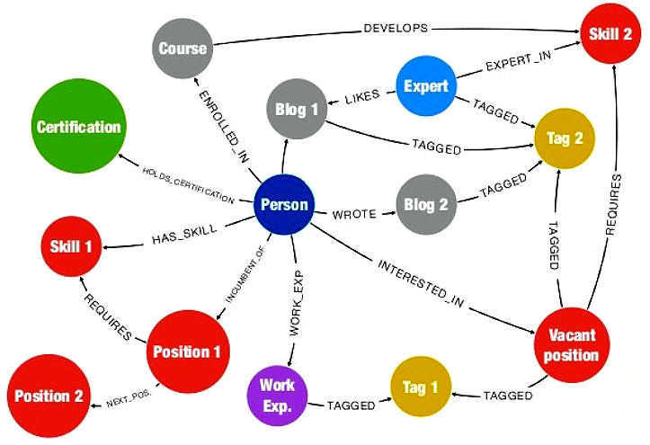
Graph Databases : Finding Hidden Potential

Slide 44
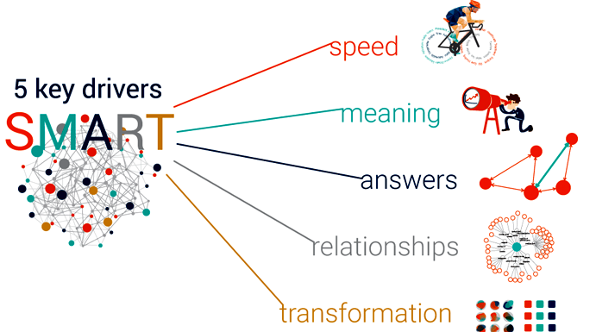
Graph Databases

Slide 45
Graph Databases
Use Cases
Fraud Detection
Knowledge Graph
Network Infrastructure Monitoring
Recommendation Engines
Master Data Management
Social Media
Identity & Access Management
Privacy, Risk, and Compliance

Slide 46
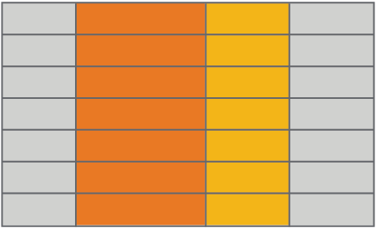
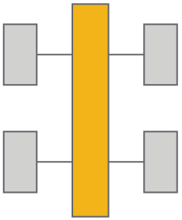
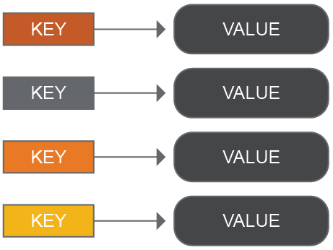
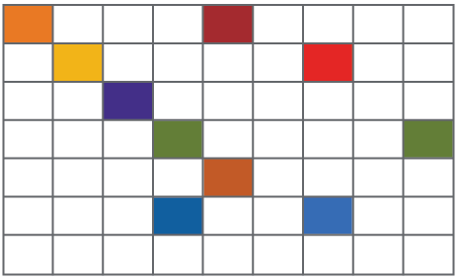
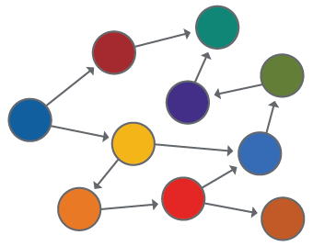
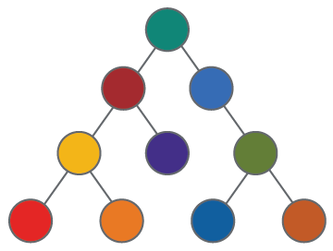
Graph Databases
The World is “Not Only SQL” (a.k.a. NoSQL)
Relational
Analytical (OLAP)
Key-Value
Column-Family
Graph
Document

Slide 47
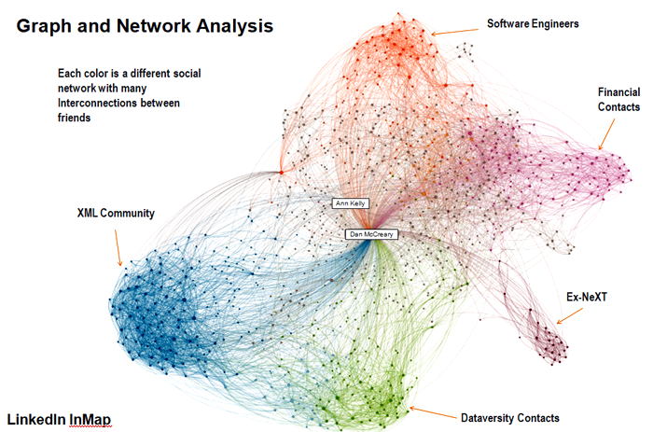
Graph Databases
Graph and Network Analysis
LinkedIn InMap

Slide 48
Recap: Graph Databases
What is a Graph Database?
In computing, a graph database (GDB) is a database that uses graph structures for semantic queries with nodes, edges and properties to represent and store data. A key concept of the system is the graph (or edge or relationship), which directly relates data items in the store - the relationships between the data are treated as vital data in the system.
A graph database is a type of NoSQL or non-relational database, which is a type of database suitable for very large sets of distributed data. Instead of using tables like those found in relational databases, uses graph structures with nodes, properties and edges in order to represent and store data.
A graph database is useful for the analysis of relationships and interconnections between data; hence, it is seeing wide use in data mining of social media data, for data with dynamic schemas, such as in supply chain management, as well as in sales, where it is used to determine the interconnections between a customer’s online actions.

Slide 49


Graph Databases
DEMO:

Slide 50
Retrospective (Graph Databases) :- Show of Hands
Questions:
How many now feel they better understand the value of capturing relationships between data as vital information?
How many now understand the concept of a many-to-many relationship, and the utility of being able to analyze the interconnectedness of data efficiently?
How many now understand that graph technology gets augmented as it gets further connected to other related graphs?

Slide 51

Quantum Computing
Quantum Computing
If you think you understand quantum mechanics, you don’t understand quantum mechanics
- Richard Feynman

Slide 52
Quantum Computing
What is Quantum Computing?
The essence of Quantum Computing is the creation of a computational system that uses quantum mechanics instead of binary logic to manifest it's underlying computational circuitry. Binary theory (Bit) only uses values of ones or zeros in it's implementation, whereas Quantum theory (QuBit) uses values of ones, zeros and everything in between. This fundamental difference appears promising when addressing the following types of difficult problems:
Computationally Hard Problems (for classical computers)
Quantum Parallelism (2^n Operations at the same time)
Quantum Simulators (elementary particle physics)

Slide 53
“Select” Computing History (Binary [240+ yrs] vs Quantum [60+ yrs])
Creating Context: History of Scientific Theory of Computation | Timelines and Innovation Spans
DARPA developing “Molecular Informatics” Program
Gottfried Wilhelm Leibniz Develops Binary Logic
George Boole Publishes Boolean Algebra – Complete system that allowed computational processes to be mathematically modeled.
Atanasoff-Berry – worlds first Digital Computer built Iowa State Campus.
1700
1702
1854
1939 - 1942
2017
2019
MIT scientists reported the discovery of a new triple-photon form of light, which may involve polaritons, that could be useful in the development of quantum computers.
Paul Benioff proposes the first recognizable theoretical framework for a quantum computer.
Roman Stanisław Ingarden publishes a seminal paper entitled "Quantum Information Theory"
First working
5-qubit NMR TU Munich
7-qubit MNR Los Alamos
University of Copenhagen develops quantum teleportation between photons and atoms.
Today
Richard Feynman conceives of using Quantum Effects for computation.
First working 3-qubit
NMR computer
First 12-qubit quantum computer benchmarked.
1950
1959
1976
1982
1998
2000
2006
2007
2018
2019
Binary Computation theory and implementation is mature and robust.
Quantum Computation theory maybe – but materials science implementation is not !

Slide 54
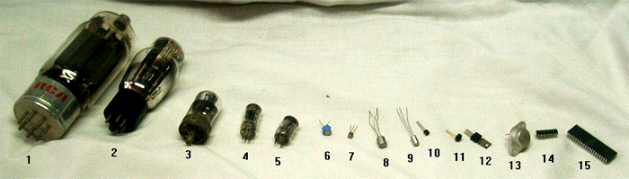
Physical Manifestation(s) of Circuits and Maturity
Creating Context
Today
Binary Computer Circuits
In the first half of the 20th century, analog computers were considered by many to be the future of computing. These devices used the continuously changeable aspects of physical phenomena such as electrical, mechanical, or hydraulic quantities to model the problem being solved, in contrast to digital computers that represented varying quantities symbolically, as their numerical values change.

Slide 55
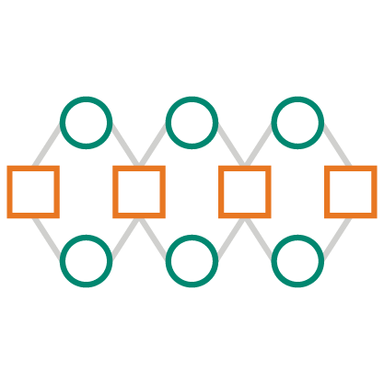

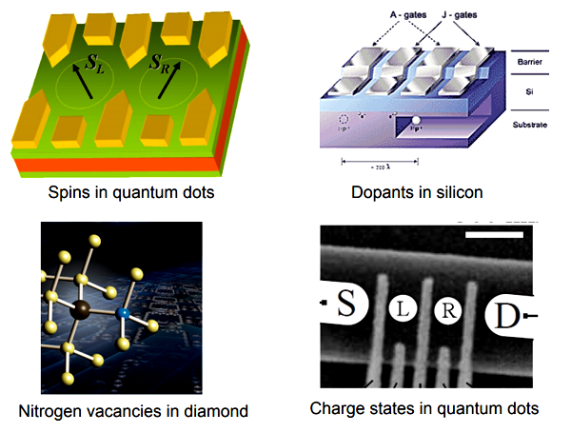
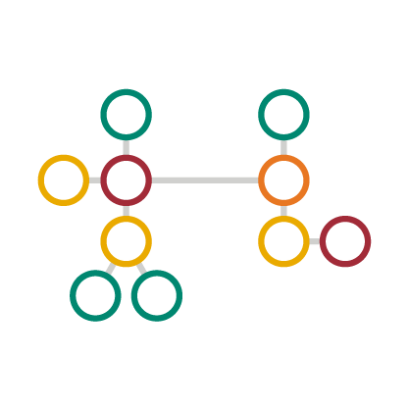

Physical Manifestation(s) of circuits and maturity
Creating Context
Quantum Computer Circuits
Types of Quantum Processors
Superconducting Circuits
Trapped Ions
Optical Traps
Quantum Dots
Diamond Vacancies
Semiconductor Impurities
Linear Quantum Optics
Trapped Ions
Electrons in Solid State
Nuclear Magnetic Resonance
Superconducting Circuits
Today

Slide 56
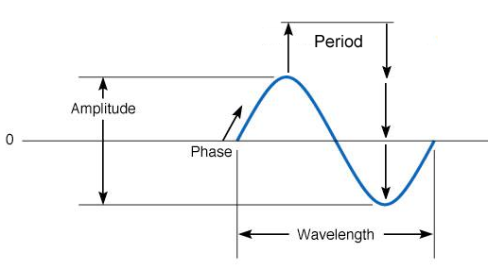
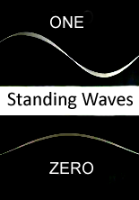
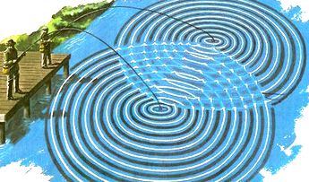
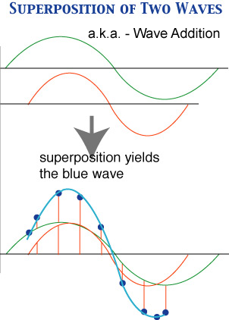
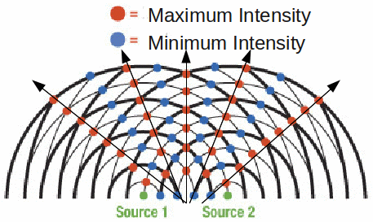
Waves
Quantum Computing Theory/Concepts
(Big Problem: Containment)
Fundamental Concepts in QC Theory
Standing Waves
Period, Amplitude, Phase, Wavelength
Superposition
Interference
Superposition of Two Waves
Wave Interference

Slide 57
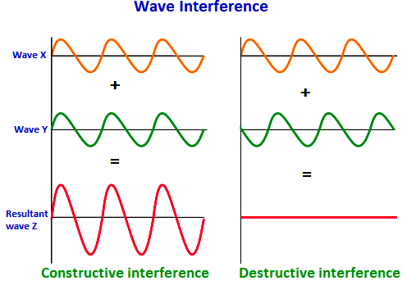
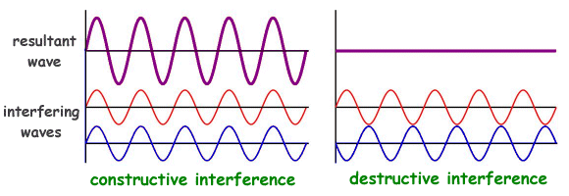
Waves
Quantum Computing Theory/Concepts
Fundamental Concepts in QC Theory
Standing Waves
Period, Amplitude, Phase, Wavelength
Superposition
Interference
Wave Interference
Superposition
One of the most important concepts you must grasp to understand quantum computing is the superposition and interference of waves. Since waves are moving through space, you can have more than one wave passing through one place at the same time. When that happens, the wave add up, or superimpose on one another.
Interference
When more than one wave pass through the same space at the same time.
1, 2 and N dimensional Interferences.

Slide 58
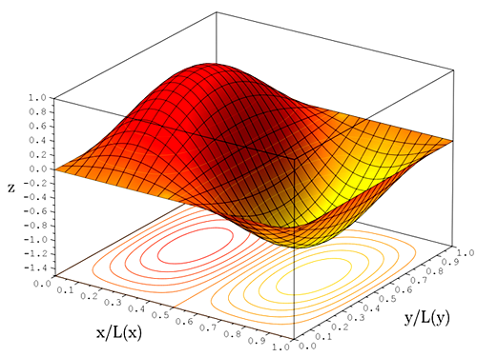
Waves
Quantum Computing Theory/Concepts
Fundamental Concepts in QC Theory
Wave Function
Schrodinger’s Equation
Generates (describes) the wave function.
(Still disagreement among researchers and theorists)

Slide 59

Waves
Quantum Computing Theory/Concepts
Fundamental Concepts in QC Theory
Wave DeCoherence
In physics, two wave sources are perfectly coherent if they have a constant phase difference and the same frequency, and the same waveform. Coherence is an ideal property of waves that enables stationary (i.e. temporally and spatially constant) interference. In quantum mechanics, particles such as electrons are described by a wavefunction, a mathematical description of the quantum state of a system; the probabilistic nature of the wavefunction gives rise to various quantum effects. As long as there exists a definite phase relation between different states, the system is said to be coherent.

Slide 60
Waves
Quantum Computing Theory/Concepts
Fundamental Concepts in QC Theory
Wave DeCoherence
This coherence is a fundamental property of quantum mechanics, and is necessary for the function of quantum computers. However, when a quantum system is not perfectly isolated, but in contact with its surroundings, the coherence decays with time, a process called quantum decoherence - collapse of the wavefunction.

Slide 61


Waves
Quantum Computing Theory/Concepts
This coherence is a fundamental property of quantum mechanics, and is necessary for the function of quantum computers. However, when a quantum system is not perfectly isolated, but in contact with its surroundings, the coherence decays with time, a process called quantum decoherence - collapse of the wavefunction.
Fundamental Concepts in QC Theory
Wave DeCoherence

Slide 62



QuBits
Quantum Computing Theory/Concepts
Binary Notation
Block Sphere Notation
KET Notation (Value & Phase)
Refresher:
QuBits model properties of waves
Like binary notation, but with in-between values
Represented by Block Sphere notation
Represented by KET Notation (ABS Value)
They have Phases
QuBits (Standing Waves) Have “Phases” – Like the Moon.
Fundamental Concepts in QC Theory
(Classical) vs Bits (Quantum)
QuBits have two Characteristics: their Value and their Phase.

Slide 63
Quantum Entanglement
Unlike ordinary bits of information, qubits can be linked in a way that has no analog in the digital world. This linkage, called entanglement, acts instantly over any distance
Qubit
4. When one of the qubits is manipulated–say, to perform a step in a quantum computer program–the manipulation happens instantly to its’ entangled twin as well
2. Once they have been entangled, they are in an indeterminate state
3. The qubits can then be separated by an distance, but they will remain linked
5. If the manipulation includes reading the state of one of the qubits, the entanglement ends, and both qubits’ states are revealed
1. Two qubits are entangled through the action of a laser

Slide 64

Quantum Teleportation
Or: What Happens to “A” will Affect “B”

Slide 65

Foundational Ideas – Quantum Supremacy
Quantum Computing Theory/Concepts
The term quantum supremacy has been used to describe demonstration of a quantum computer that can solve problems that a classical computer can not.
It is worth asking the question in the opposite direction: simulating the behavior of a quantum computer using a classical computer is hard. What’s the largest quantum computer we can simulate? We have talked about the exponential growth in the size of our state vector with the number of Qubits. This can serve as a rough guide to what is possible:
From this kind of table, and experience with large-scale quantum simulations, researchers reasoned that classical computers would struggle to simulate quantum computers larger than fifty qubits. Therefore, a quantum computer of fifty qubits or more should be able to do things that a classical computer can’t.

Slide 66

Creating Context: State of the Art
The promise of quantum computation is real, but the technological hurdles are huge. There seems to be no clear or obvious champion in the race to achieve fault tolerant quantum computation.
Quantum circuits can solve some important problems with exponentially fewer operations than classical algorithms
Small quantum circuits have been demonstrated in the lab using various physical technologies
Quantum cryptography has been demonstrated over long distances
Current technologies are fragile, and appear to be limited to tens of qubits and hundreds of gates
Big gaps remain in our understanding of quantum circuit and algorithm design, as well as the necessary implementation techniques

Slide 67
Quantum Teleportation
Quantum Computing
DEMO
Or: What Happens to “A” will Affect “B”
QuBits have two Characteristics: their Value and their Phase.

Slide 68
Retrospective (Quantum Computing) :- Show of Hands
Questions:
How many now feel they better understand the state of the art of quantum computing?
How many now feel they better understand how the underlying theory of information (in this case quantum) creates new capabilities as we manifest them in reality?
How many now feel they know at least one point of demarcation when quantum computers will be able to do things that classical computers cannot?

Slide 69
Optum Tech University College of Artificial Intelligence Funded by OTU

Slide 70

First Graduating Cohort
Class of 2018
Triet Pham
Chris Hamling
Allison Senden
Abdi Norkadi
Gary Yang
Matt Versaggi
Johnathan Schultz

Slide 71
Questions?

Slide 72


How did we do?
crowdpurr.live/ AI2018
Notes:
Presenter’s View: https://app.crowdpurr.com/experienceViewer/QE5dLeq3dqbmZuGGY

